Slide 1
甜甜圈的寓言
The Donuts Allegory

Slide 2
讀經:
耶利米書 18:1-4
Scripture:
Jeremiah 18:1-4

Slide 3
耶利米書 18:1-4
神的話臨到耶利米說:「你起來, 下到窯匠的家裡去, 我在那裡要使你聽我的話。
」
我就下到窯匠的家裡去, 正遇他轉輪做器皿。窯匠用泥做的器皿在他手中做壞了, 他又用這泥另做別的器皿。窯匠看怎樣好, 就怎樣做。

Slide 4
我就下到窯匠的家裡去, 正遇他轉輪做器皿。

Slide 5
窯匠用泥做的器皿在他手中做壞了, 他又用這泥另做別的器皿。窯匠看怎樣好, 就怎樣做。

Slide 6
Jeremiah 18:1-4
This is the word that came to Jeremiah from the Lord:
“Go down to the potter’s house, and there I will give you my message.” 3 So I went down to the potter’s house, and I saw him working at the wheel. 4 But the pot he was shaping from the clay was marred in his hands; so the potter formed it into another pot, shaping it as seemed best to him.

Slide 7
“Go down to the potter’s house, and there I will give you my message.”
So I went down to the potter’s house, and I saw him working at the wheel. 4 But the pot he was shaping from the clay was marred in his hands; so the potter formed it into another pot, shaping it as seemed best to him.

Slide 8
So I went down to the potter’s house, and I saw him working at the wheel.

Slide 9
But the pot he was shaping from the clay was marred in his hands;
so the potter formed it into another pot, shaping it as seemed best to him.

Slide 10
so the potter formed it into another pot, shaping it as seemed best to him.

Slide 11
甜甜圈的寓言
The Donuts Allegory

Slide 12
如何製作甜甜圈？
1.麵粉與水, 酵母,鹽, 糖, 蛋和油混合

Slide 13
How to make donuts?
1. Flour mixed with water, yeast, salt, sugar, egg and oil

Slide 14
將麵粉與水混合後，透過揉捏就會變成有彈性的麵筋。

Slide 15
When flour is mixed with water, it turns into the elastic gluten when kneaded.

Slide 16
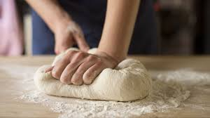

Slide 17
酵母將糖轉變為二氧化碳，並將澱粉，蛋白質和脂肪分解為更基本的分子。

Slide 18
The yeast turns sugar into CO₂ and breaks down starch, protein, and fat into more basic molecules.

Slide 20
CO₂被麵筋捕獲包住，麵團就膨脹起來。
The CO₂ is trapped by the elastic gluten and the dough rises.

Slide 21
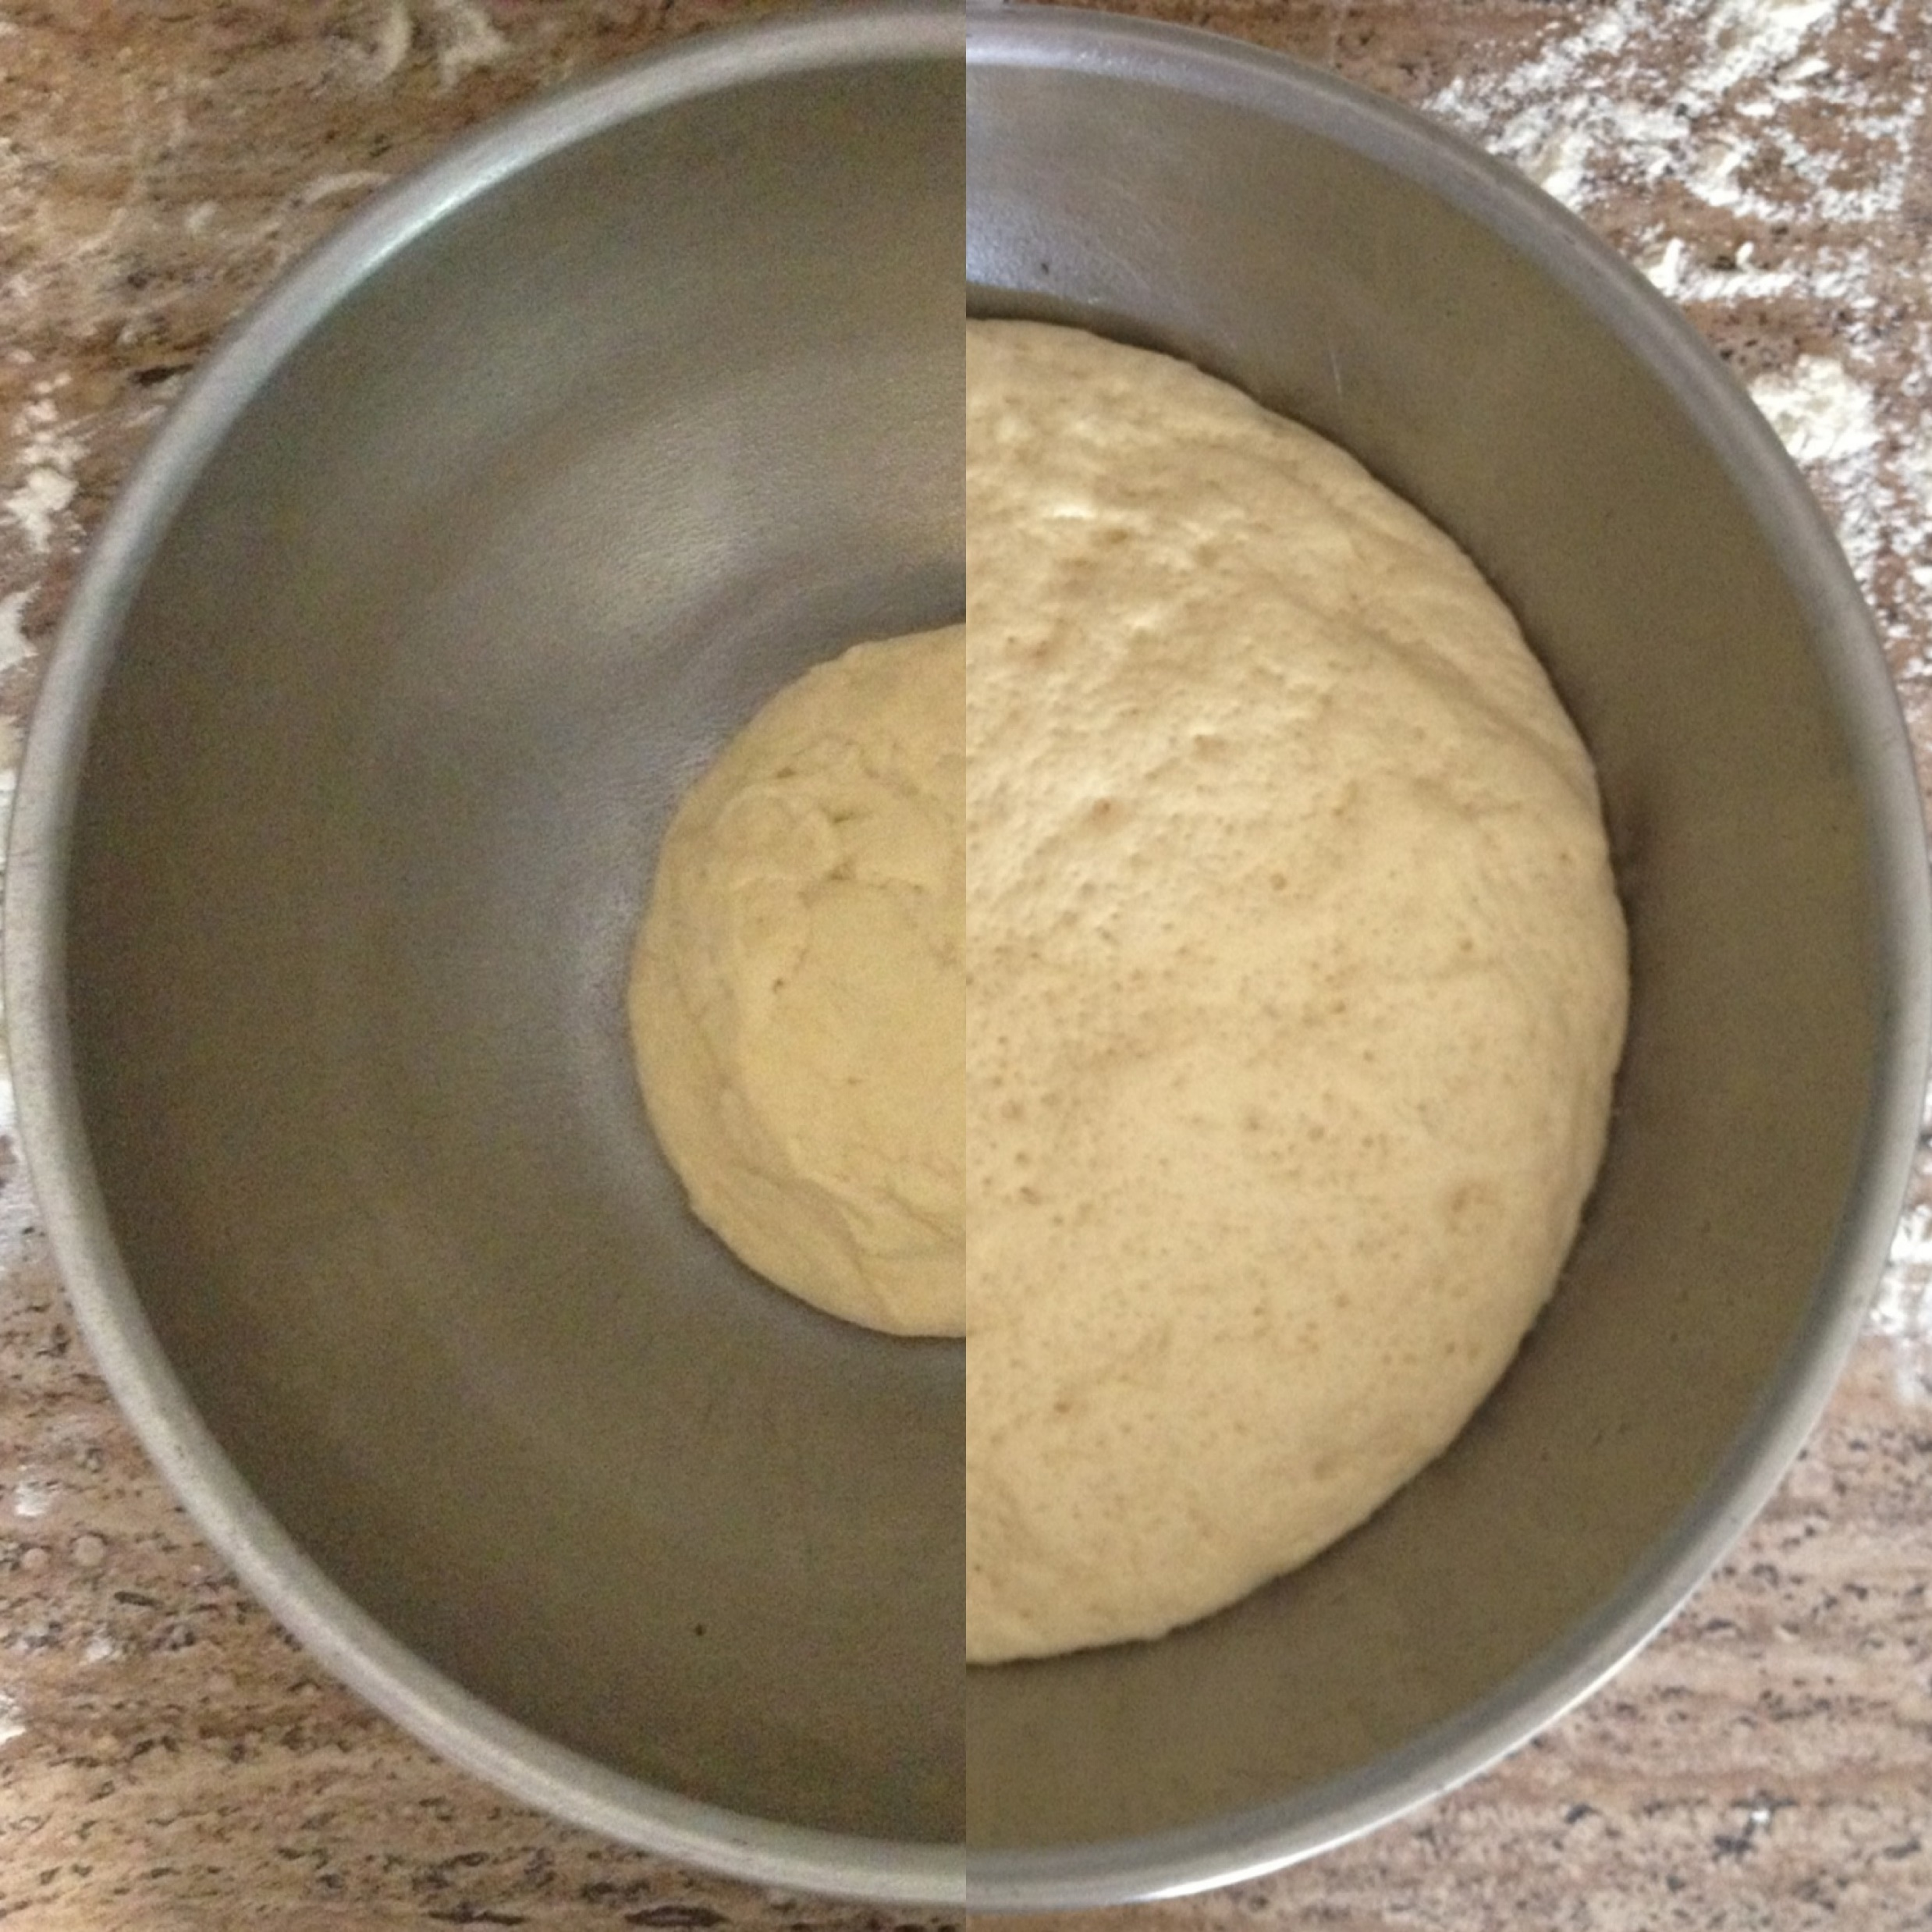

Slide 22
將麵團切成甜甜圈的形狀。
Cut the dough into the shapes of donuts.

Slide 23
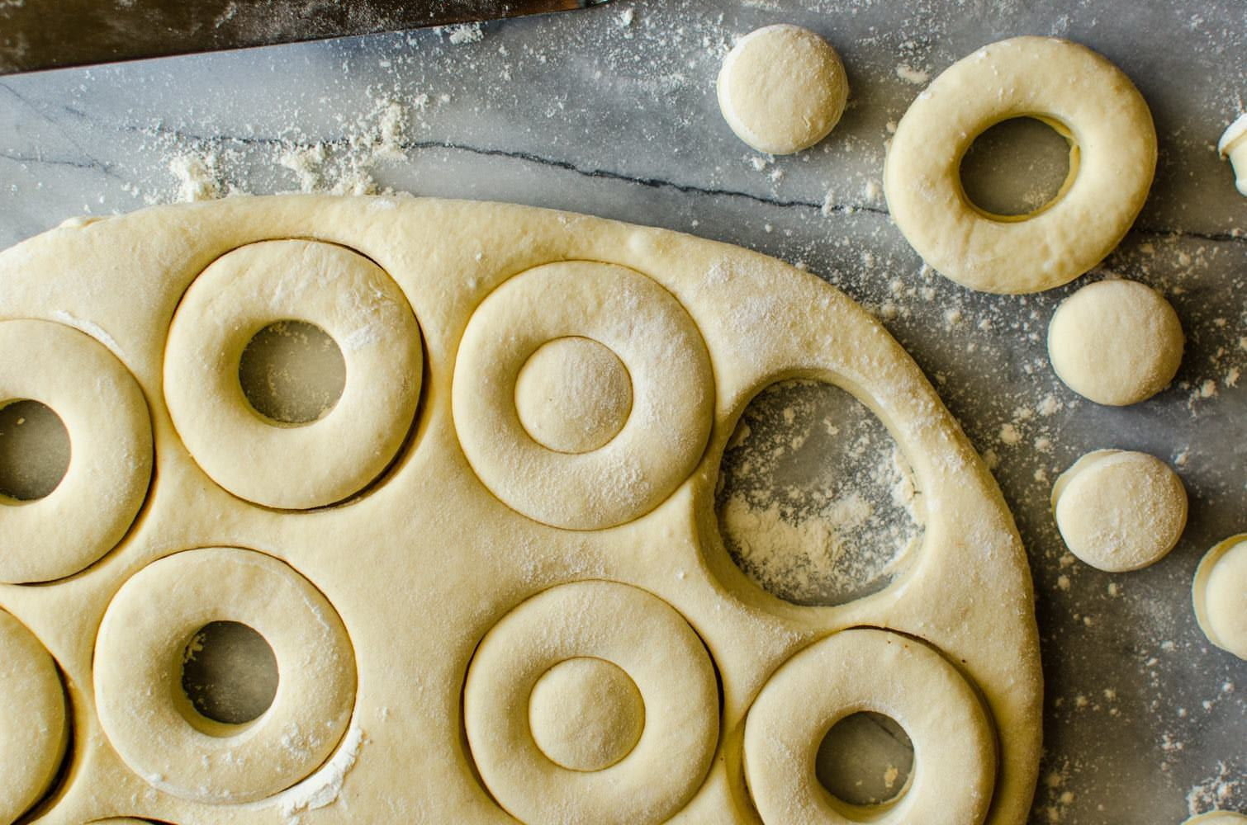

Slide 24
把這有切好及有洞的麵團油炸後，它會變成蓬鬆的甜甜圈。

Slide 25
When the dough with the hole is fried, it turns into fluffy donuts.

Slide 26
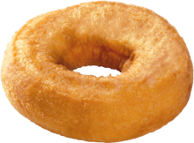

Slide 27
甜甜圈很軟是因為那個洞讓熱量快速又均勻地到達所有的部分。

Slide 28
The donut can be soft because the hole allowed heat to get to all parts quickly and evenly.

Slide 29
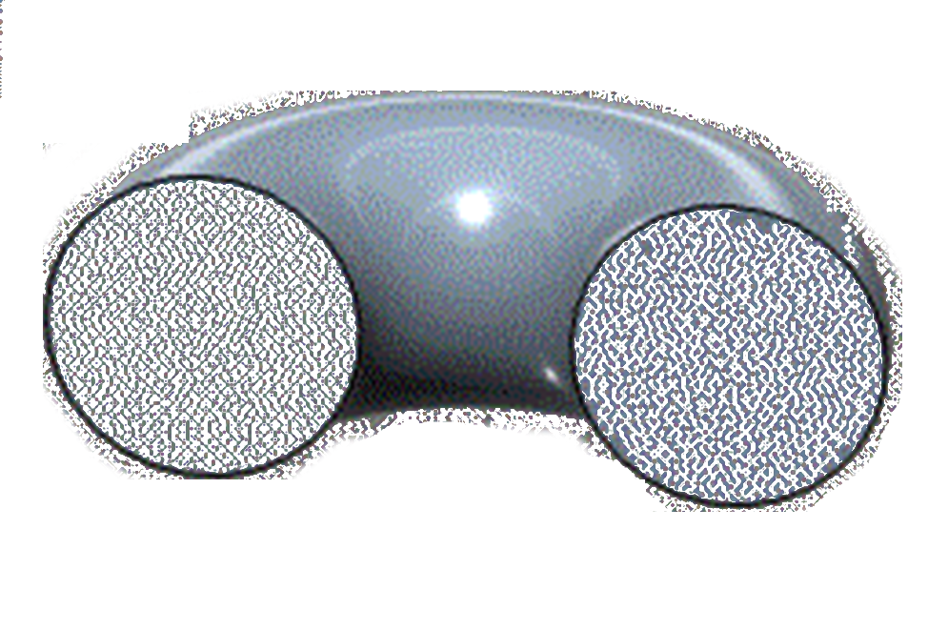

Slide 30
沒有中間的洞，炸起來的甜甜就圈不會那麼蓬鬆柔軟。 它就不會像是我們喜歡的甜甜圈。

Slide 31
Without the hole, a donut won’t be as fluffy and soft. It won’t taste like a donut that we like.

Slide 32
我們的生命就像是這些甜甜圈。 我們有些人希望填補其中的“洞”:

Slide 33
Our lives are like donuts. There are holes that some of us would like filled:

Slide 34
貧窮
疾病
損失,失去親友
被欺負,虐待
失敗,挫則
大的風浪,混亂
Poverty
Illness
Losses
Abuse Failures
Turmoil

Slide 35
像甜甜圈上的洞一樣，這些缺陷可以使我們變得更好。

Slide 36
Like the holes in donuts, these deficiencies can make us better.

Slide 37
這些洞能帶給我們什麼？
What can these holes bring us?

Slide 38
毅力 – 不要輕易放棄自己、其他的人、和各種各樣的事情。

Slide 39
Perseverance – Do not give up on yourself, others, and various things so easily.

Slide 40
雅各書 1:2-4
我的弟兄們，你們落在百般試煉中，都要以為大喜樂，
因為知道，你們的信心經過試驗就生忍耐。 但忍耐也當成功，使你們成全、完備，毫無缺欠。

Slide 41
因為知道，你們的信心經過試驗就生忍耐。 但忍耐也當成功，使你們成全、完備，毫無缺欠。

Slide 42
James 1:2-4
Consider it pure joy, my brothers and sisters, whenever you face trials of
many kinds, because you know that the testing of your faith produces perseverance. Let perseverance finish its work so that you may be mature and complete, not lacking anything.

Slide 43
many kinds, because you know that the testing of your faith produces perseverance.

Slide 44
Let perseverance finish its work so that you may be mature and complete, not lacking anything.

Slide 45
忍耐力 - 可以忍受痛苦且仍然不會失去信心和希望。

Slide 46
Endurance – Can endure the pain and still not lose faith and hope.

Slide 47
羅馬書 5:3-4 - 不但如此, 就是在患難中也是歡歡喜喜的。因為知道患難生忍耐, 忍耐生老練, 老練生盼望，

Slide 48
Romans 5:3-4 - Not only so, but we also glory in our sufferings, because we know that
suffering produces perseverance; perseverance, character; and character, hope.

Slide 49
suffering produces perseverance; perseverance, character; and character, hope.

Slide 50
信心和對神的依靠– 相信神愛你以及你可以依靠祂。

Slide 51
Faith & reliance on God – Believe that God loves you and you can count on Him.

Slide 52
腓立比書 4:13
我靠著那加給我力量的，凡事都能做。

Slide 53
Philippians 4:13
I can do all this through Him who gives me strength.

Slide 54
哥林多後書 12:7-9
又恐怕我因所得的啟示甚大，就過於自高，所以有一根刺加在我肉體上，
就是撒旦的差役要攻擊我，免得我過於自高。 為這事，我三次求過主，叫這刺離開我。 他對我說：「我的恩典夠你用的，因為我的能力是在人的軟弱上顯得完全。」所以，我更喜歡誇自己的軟弱，好叫基督的能力覆庇我。

Slide 55
就是撒旦的差役要攻擊我，免得我過於自高。 為這事，我三次求過主，叫這刺離開我。

Slide 56
他對我說：「我的恩典夠你用的，因為我的能力是在人的軟弱上顯得完全。」

Slide 57
所以，我更喜歡誇自己的軟弱，好叫基督的能力覆庇我。

Slide 58
2 Corinthians 12:7-9
In order to keep me from becoming conceited, I was given a thorn in my flesh,
a messenger of Satan, to torment me. Three times I pleaded with the Lord to take it away from me. But he said to me, “My grace is sufficient for you, for my power is made perfect in weakness.” Therefore I will boast all the more gladly about my weaknesses, so that Christ’s power may rest on me.

Slide 59
a messenger of Satan, to torment me. Three times I pleaded with the Lord to take it away from me.

Slide 60
But he said to me, “My grace is sufficient for you, for my power is made perfect in weakness.”

Slide 61
Therefore I will boast all the more gladly about my weaknesses, so that Christ’s power may rest on me.

Slide 62
對他人的同情與鼓勵 – 被治癒的人最可以治愈他人。

Slide 63
Compassion & encouragement to others – Healed people can best heal people.

Slide 64
無家可歸者和一隻狗的故事…
The story of the homeless and the dog…

Slide 65
謙卑 – 我們可以看清我們真正的自己 - 我們是需要神的不完美的人

Slide 66
Humility – We see ourselves as who we really are – imperfect beings who need God

Slide 67
哥林多前書1:28-29
神也揀選了世上卑賤的、被人厭惡的以及那無有的，
為要廢掉那有的，使一切有血氣的，在神面前一個也不能自誇。

Slide 68
為要廢掉那有的，使一切有血氣的，在神面前一個也不能自誇。

Slide 69
1 Corinthians 1:28-29
God chose the lowly things of this world and the despised things --
and the things that are not -to nullify the things that are, so that no one may boast before him.

Slide 70
and the things that are not -- to nullify the things that are, so that no one may boast before him.

Slide 71
什麼可以幫助我們獲得這些易處呢？
What can help us get those benefits?

Slide 72
正確的視角：從神的角度看事物的真實面貌

Slide 73
Right Perspective: See things as they really are – from God’s perspective

Slide 74
塵世生活只是一個考驗和訓練的場所
Our earthly life is only a test and a training ground

Slide 75
耶利米書 18:1-4
耶和華的話臨到耶利米說:「你起來, 下到窯匠的家裡去,我在那裡要使你聽我的話。」
我就下到窯匠的家裡
去，正遇他轉輪做器皿。 窯匠用泥做的器皿在他手中做壞了，他又用這泥另做別的器皿。窯匠看怎樣好，就怎樣做。

Slide 76
去, 正遇他轉輪做器皿。 窯匠用泥做的器皿在他手中做壞了,他又用這泥另做別的器皿。窯匠看怎樣好，就怎樣做。

Slide 77
Jeremiah 18:1-4
This is the word that came to Jeremiah from the Lord: “Go down to the potter’s house, and there
I will give you my message.” So I went down to the potter’s house, and I saw him working at the wheel. But the pot he was shaping from the clay was marred in his hands; so the potter formed it into another pot, shaping it as seemed best to him.

Slide 78
I will give you my message.” So I went down to the potter’s house, and I saw him working at the wheel. But the pot he was

Slide 79
shaping from the clay was marred in his hands; so the potter formed it into another pot, shaping it as seemed best to him.

Slide 80
地上的生命是虛幻的和短暫的。 來世是真實而永恆的。

Slide 81
Earthly life is illusionary and temporary. Afterlife is real and eternal.

Slide 82
哥林多後書4:16-17
所以我們不喪膽，外體雖然毀壞，內心卻一天新似一天。
我們這至暫至輕的苦楚，要為我們成就極重無比、永遠的榮耀。

Slide 83
我們這至暫至輕的苦楚，要為我們成就極重無比、永遠的榮耀。

Slide 84
2 Corinthians 4:16-17
Therefore we do not lose heart. Though outwardly we are wasting away, yet
inwardly we are being renewed day by day. For our light and momentary troubles are achieving for us an eternal glory that far outweighs them all.

Slide 85
inwardly we are being renewed day by day. For our light and momentary troubles are

Slide 86
achieving for us an eternal glory that far outweighs them all.

Slide 87
正確的態度 – 要以喜樂及希望來面對這些事情，而不是以生氣或悲傷

Slide 88
Right Attitude – Face these with joy and hope, not anger or sadness

Slide 89
知足 – 對自己擁有的東西感到滿足，且不要嫉妒他人

Slide 90
Contentment – Be happy with what you have and not be envious of others

Slide 91
腓立比書 4:10-13
我靠主大大地喜樂，因為你們思念我的心如今又發生；你們向來就思念我，
只是沒得機會。 我並不是因缺乏說這話，我無論在什麼景況都可以知足，這是我已經學會了。 12 我知道怎樣處卑賤，也知道怎樣處豐富，或飽足或飢餓，或有餘或缺乏，隨事隨在，我都得了祕訣。 13 我靠著那加給我力量的，凡事都能做。

Slide 92
只是沒得機會。 我並不是因缺乏說這話，我無論在什麼景況都可以知足，這是我已經學會了。
我知道怎樣處卑賤，也知道怎樣處豐富，或飽足或飢餓，或有餘或缺乏，隨事隨在，我都得了祕訣。 13 我靠著那加給我力量的，凡事都能做。

Slide 93
我知道怎樣處卑賤,也知道怎樣處豐富,或飽足或飢餓, 或有餘或缺乏, 隨事隨在, 我都得了祕訣。

Slide 94
我靠著那加給我力量的，凡事都能做。

Slide 95
Philippians 4:10-13
I rejoiced greatly in the Lord that at last you renewed your concern for me.
Indeed, you were concerned, but you had no opportunity to show it. 11 I am not saying this because I am in need, for I have learned to be content whatever the circumstances. 12 I know what it is to be in need, and I know what it is to have plenty. I have learned the secret of being content in any and every situation, whether well fed or hungry, whether living in plenty or in want. I can do all this through him who gives me strength.

Slide 96
Indeed, you were concerned, but you had no opportunity to show it. I am not saying this because

Slide 97
I am in need, for I have learned to be content whatever the circumstances. I know what it is to

Slide 98
be in need, and I know what it is to have plenty. I have learned the secret of being content in

Slide 99
any and every situation, whether well fed or hungry, whether living in plenty or in want.

Slide 100
I can do all this through him who gives me strength.

Slide 101
希望 – 幫助我們忍受並不喪失信心Hope – helps us endure and keep our faith

Slide 102
信心 – 相信神對你有最好的意圖
Faith – Believe that God has the best intention for you

Slide 103
羅馬書 8:28
我們曉得萬事都互相效力，叫愛神的人得益處，就是按他旨意被召的人。

Slide 104
Romans 8:28
And we know that in all things God works for the good of those who love him,
who have been called according to his purpose.

Slide 105
who have been called according to his purpose.

Slide 106
耶利米書 29:11
耶和華說: 我知道我向你們所懷的意念是賜平安的意念，不是降災禍的意念，要叫你們末後有指望。

Slide 107
Jeremiah 29:11
“For I know the plans I have for you,” declares the Lord,
“plans to prosper you and not to harm you, plans to give you hope and a future.

Slide 108
“plans to prosper you and not to harm you, plans to give you hope and a future.”

Slide 109
相信神的時機和方法比你自己想要的好。
Believe that God’s timing and methods are better than yours.

Slide 110
接下來的四個講道 – 如何克服逆境。Next four sermons – how to overcome adversity.

